Slide 1
Overview
- value ratio
- z-score -> rank norm -> rank ratio
- z-score -> rank norm -> rank difference
- ComBat -> value ratio
- ComBat -> z-score -> rank norm -> rank ratio
- ComBat -> z-score -> rank norm -> rank difference

Slide 2
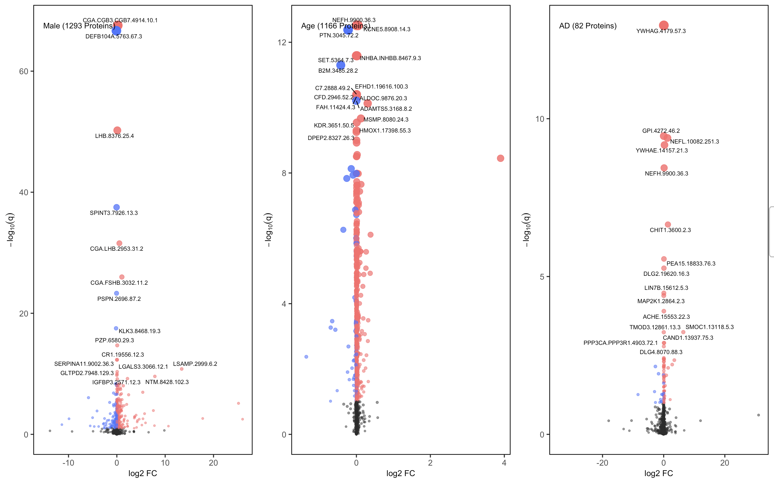
Raw CSF / Plasma Values
Variables: Sex, Age, Drawdate diff, Diagnosis, Storage days, Batch effect

Slide 3
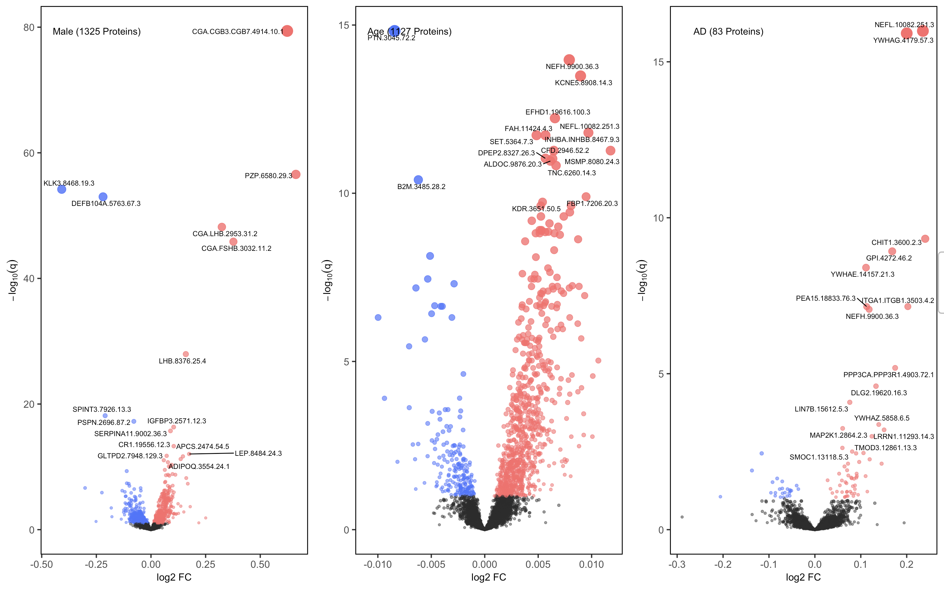
log(CSF / Plasma) Values
Variables: Sex, Age, Drawdate diff, Diagnosis, Storage days, Batch effect

Slide 4
log(CSF / Plasma) Values
Note that log(CSF / Plasma) is different from log(CSF) / log(Plasma),
and in this case, the logarithm was applied to just make the fold changes more pronounced
Variables: Sex, Age, Drawdate diff, Diagnosis, Storage days, Batch effect

Slide 5
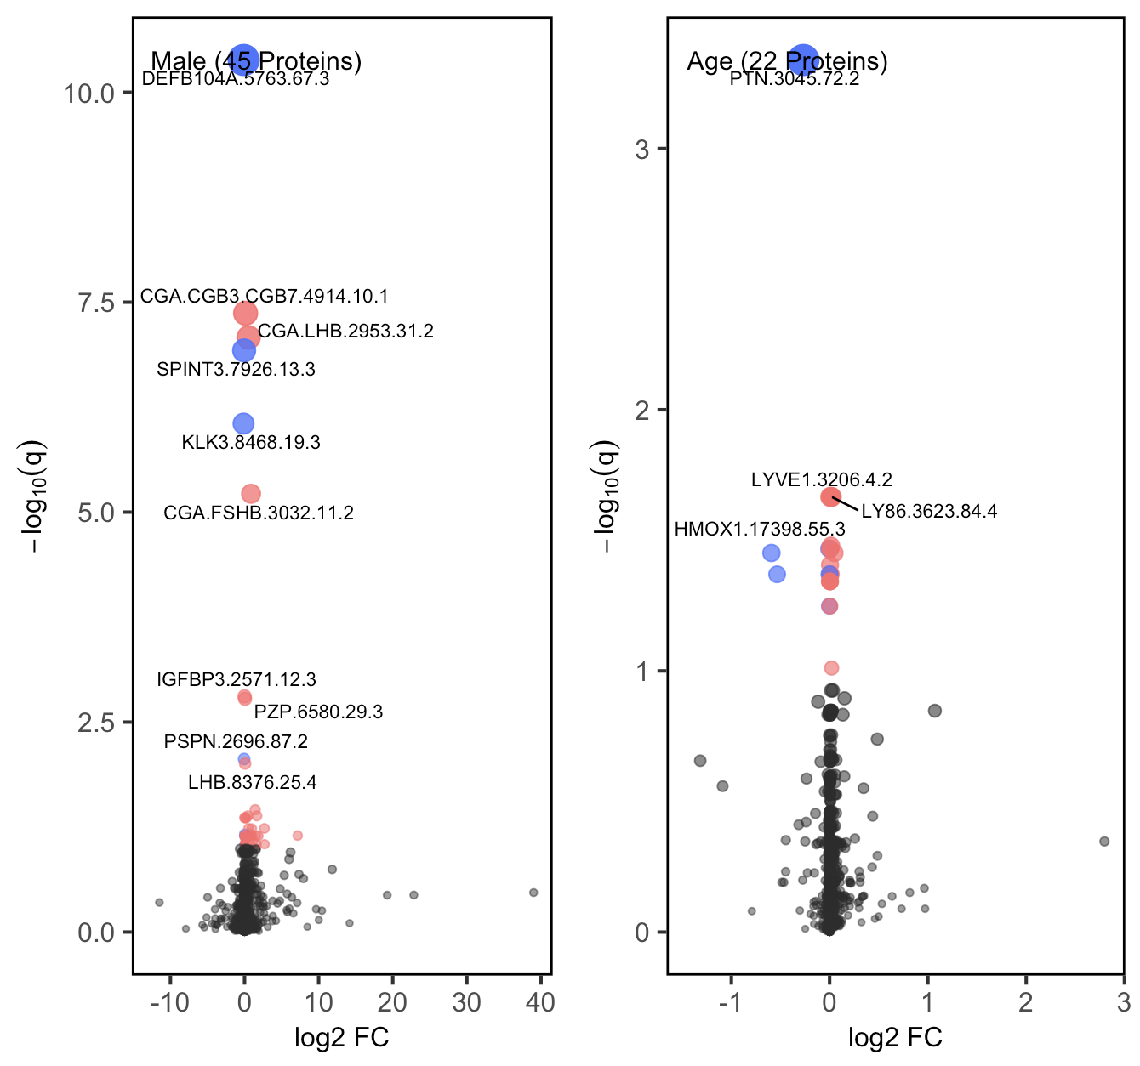
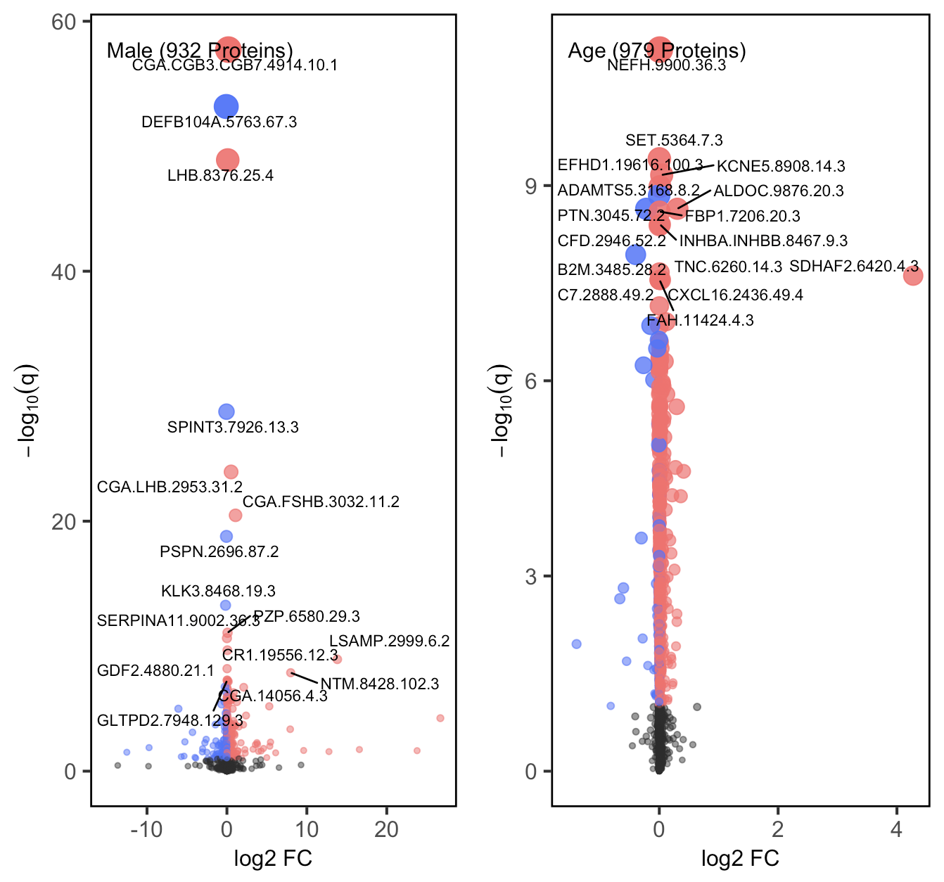
Raw CSF / Plasma Values: Stratified by Diagnosis
AD Group
CO Group
Variables: Sex, Age, Drawdate diff, Storage days, Batch effect

Slide 6
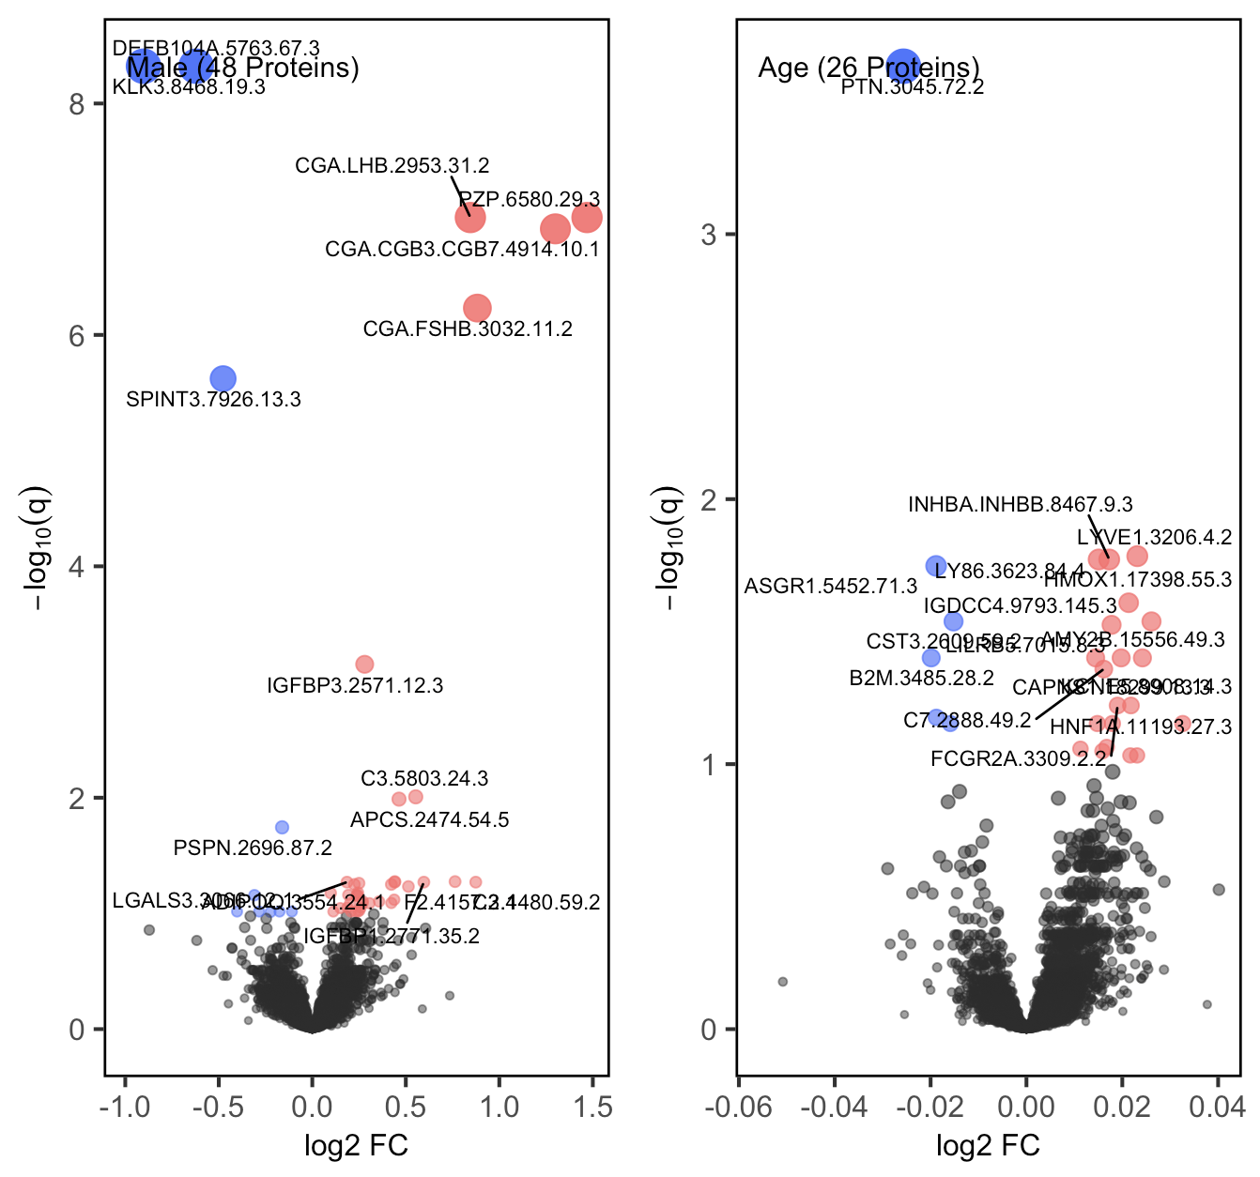
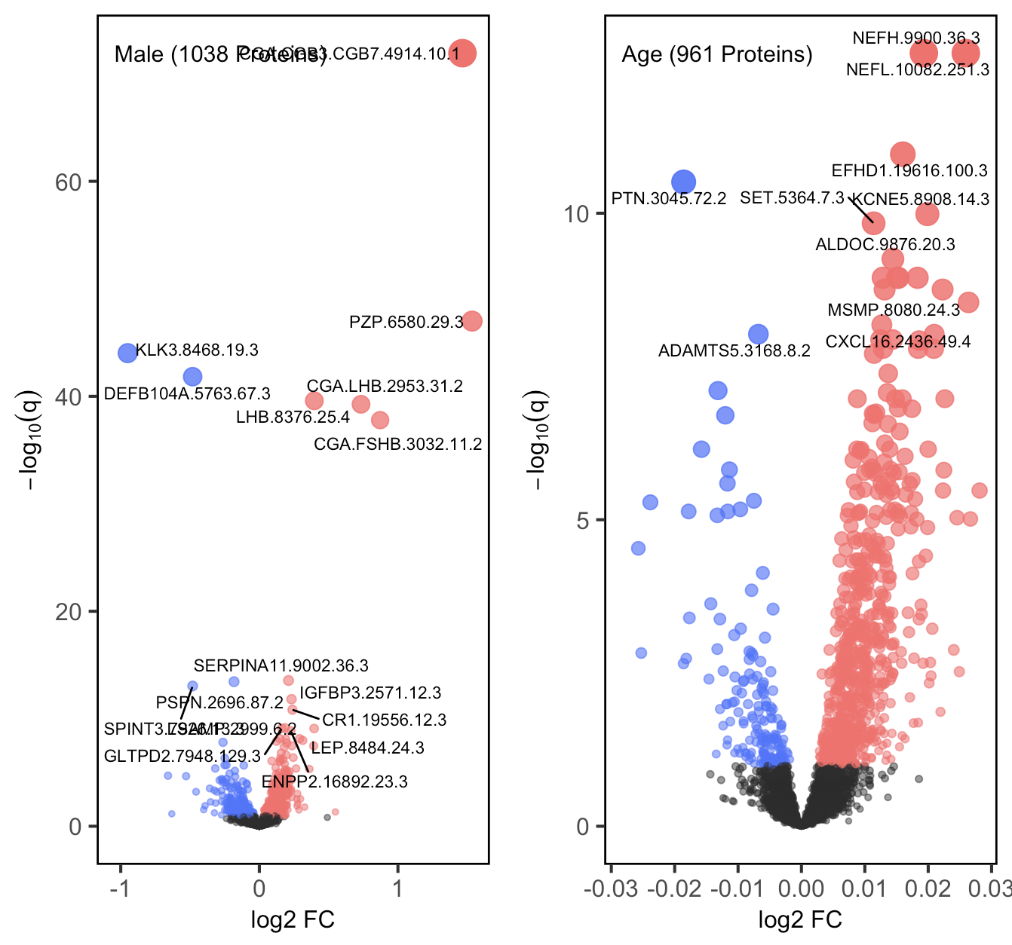
log(CSF / Plasma) Values: Stratified by Diagnosis
AD Group
CO Group
Variables: Sex, Age, Drawdate diff, Storage days, Batch effect

Slide 7
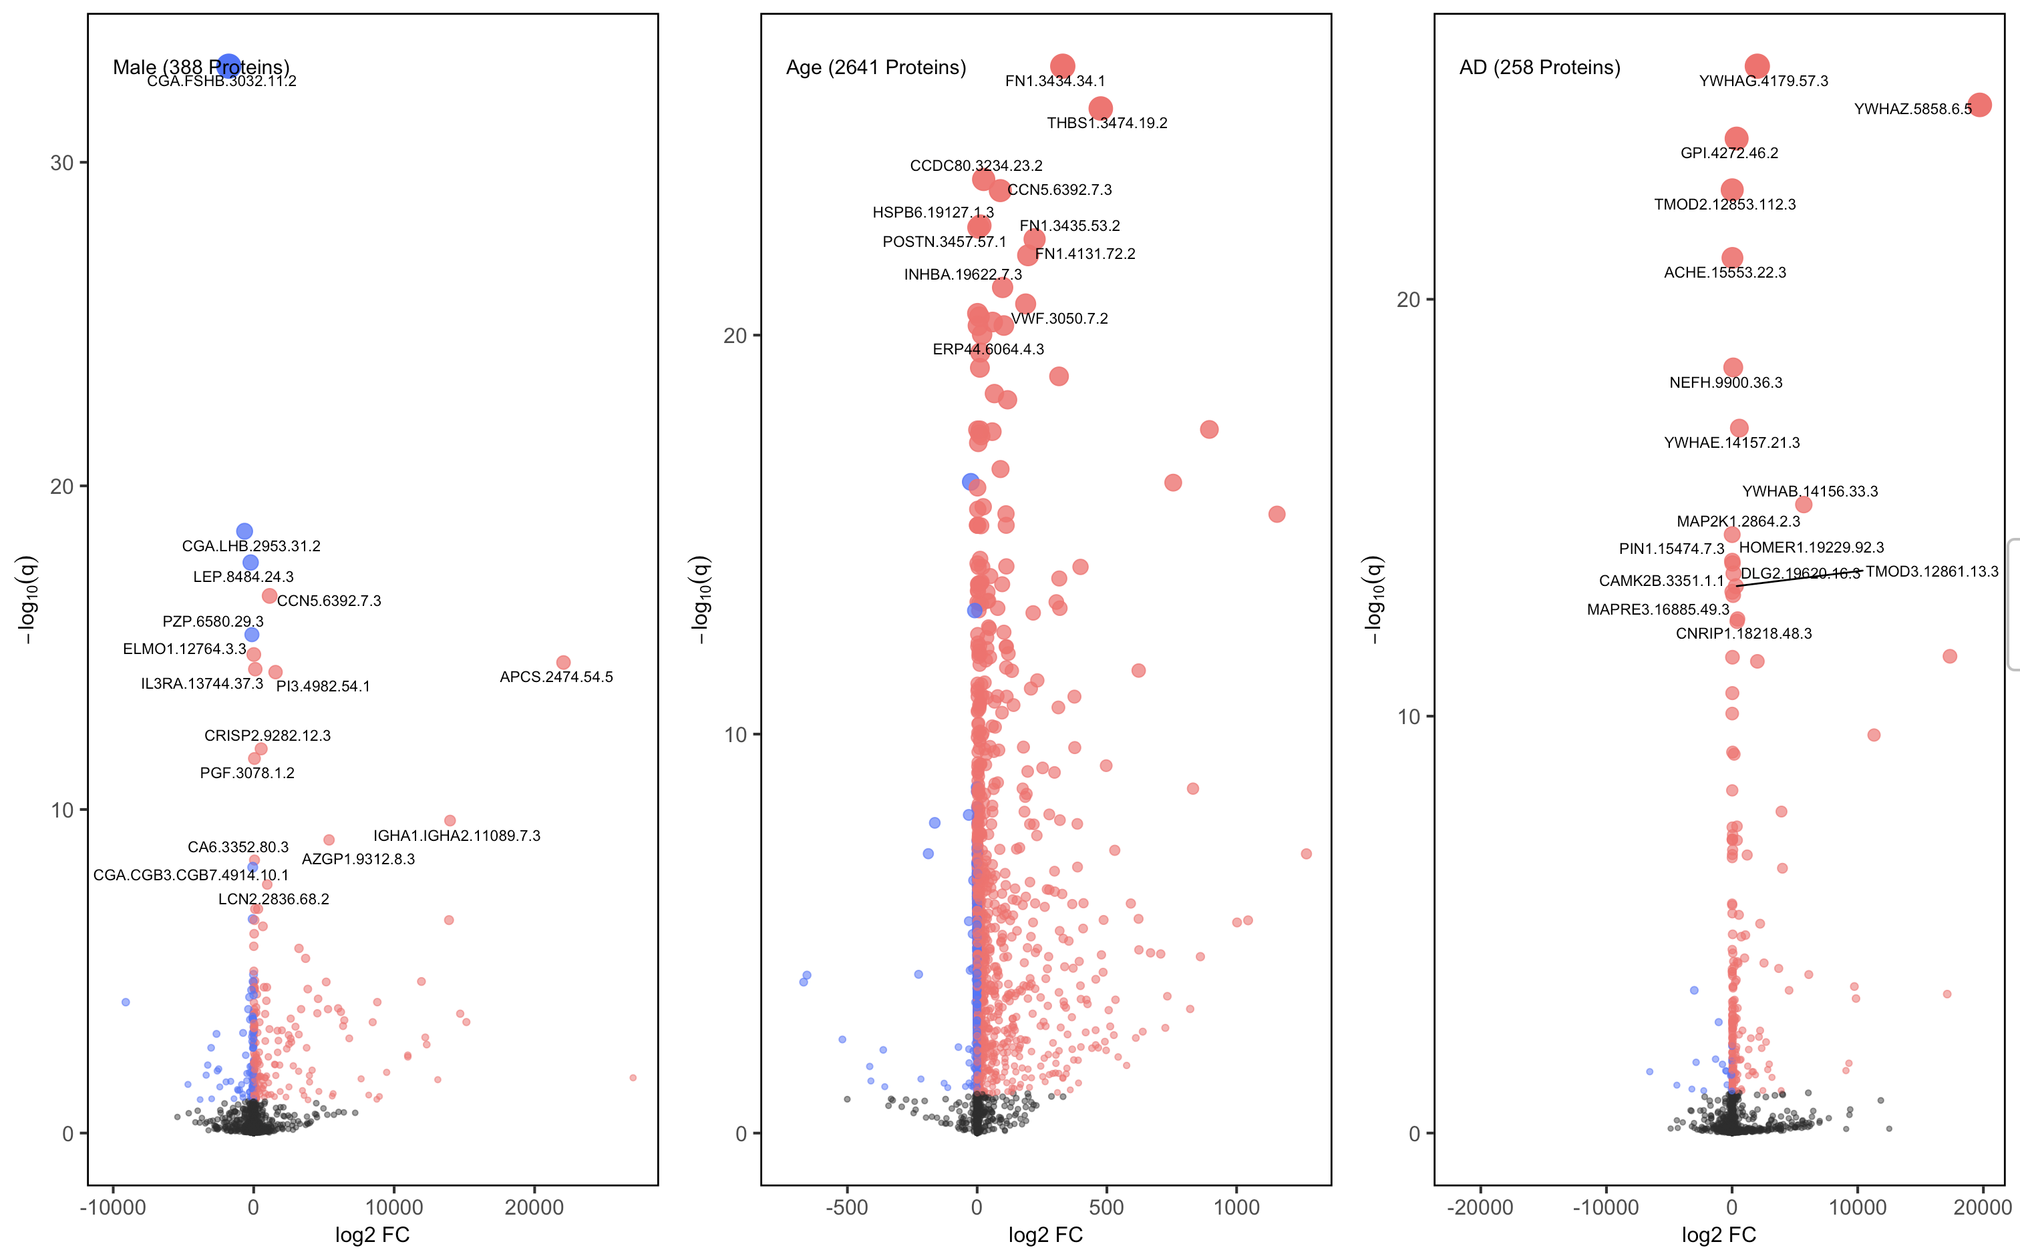
Raw CSF Values
Variables: Sex, Age, Drawdate diff, Diagnosis, Storage days, Batch effect

Slide 8
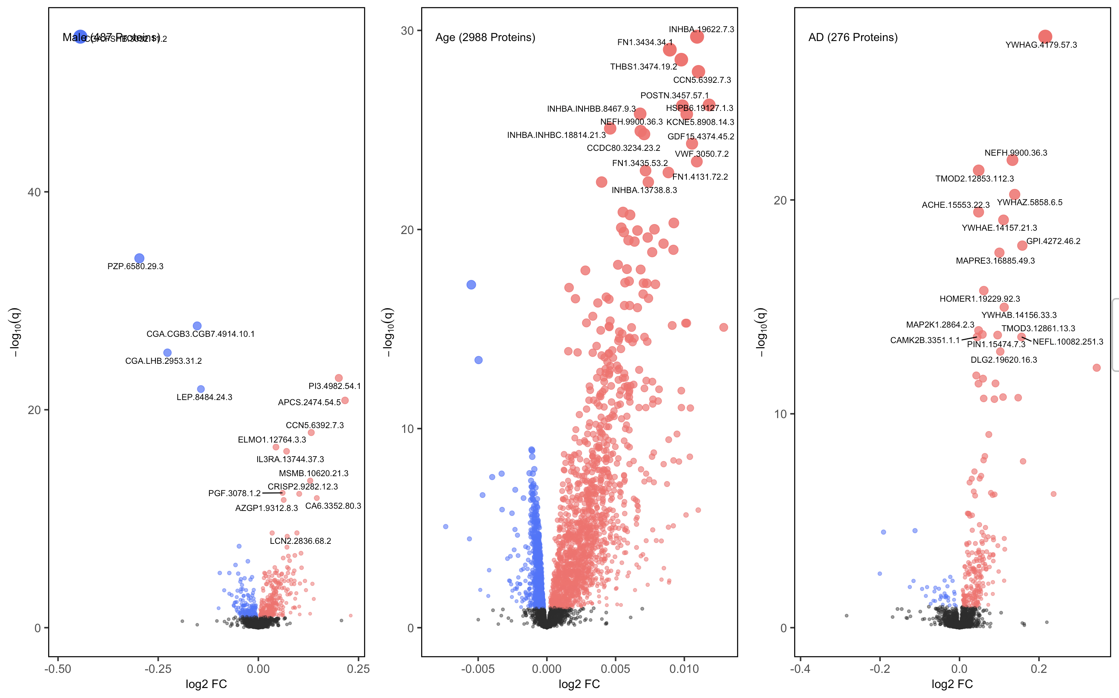
Raw log(CSF) Values
Variables: Sex, Age, Drawdate diff, Diagnosis, Storage days, Batch effect

Slide 9
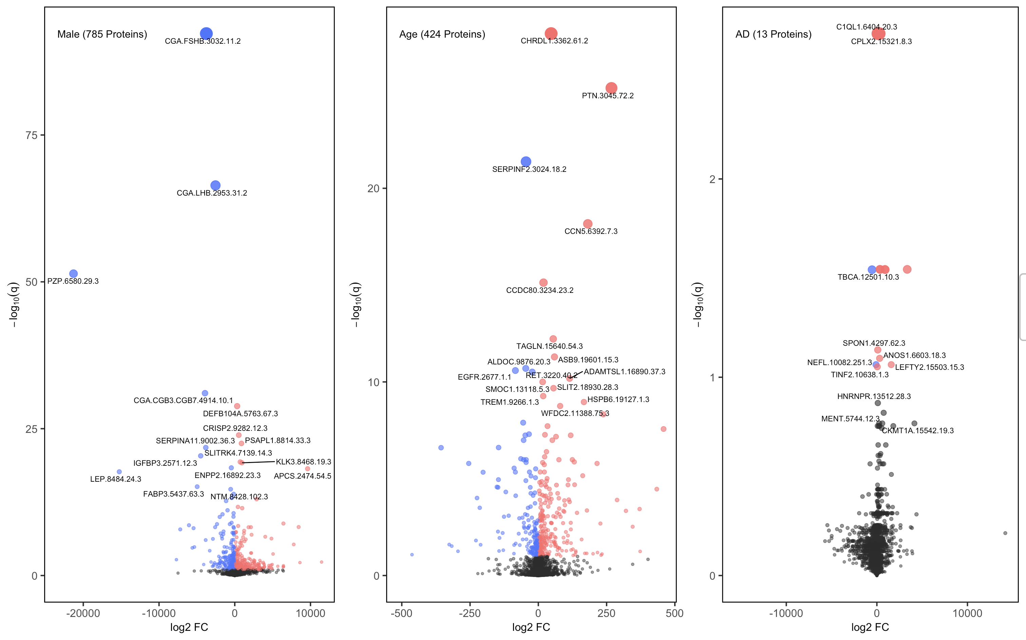
Raw Plasma Values
Variables: Sex, Age, Drawdate diff, Diagnosis, Storage days, Batch effect

Slide 10
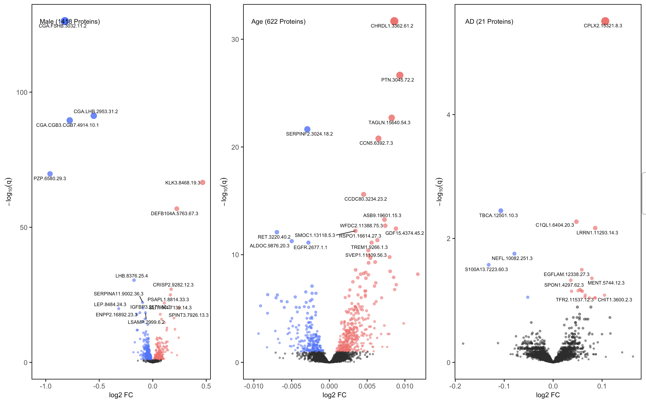
log(Plasma) Values
Variables: Sex, Age, Drawdate diff, Diagnosis, Storage days, Batch effect

Slide 11
Raw Plasma
For Combined (Stanford + Knight <120 days) dataset. CSF – Plasma Ratio
Variables: Sex, Age, Drawdate diff, Storage days, Batch effect
AD (Left), CO (Right)

